Slide 1
Unit 1: Introductions and Course Overview

Slide 2

Student Introductions
Please present your:
  Name.
  Department or agency.
  Greatest need from this course.

Slide 3
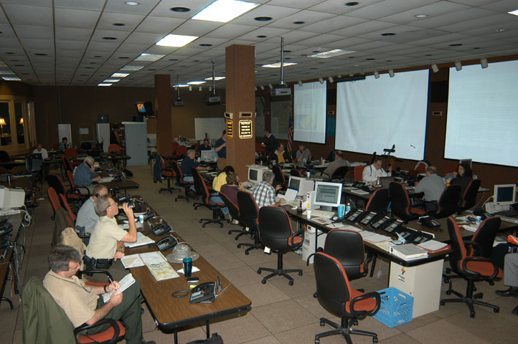
Course Goals
Identify the legal basis for continuity planning.
Explain the roles and responsibilities of the Continuity Program Manager.

Slide 4
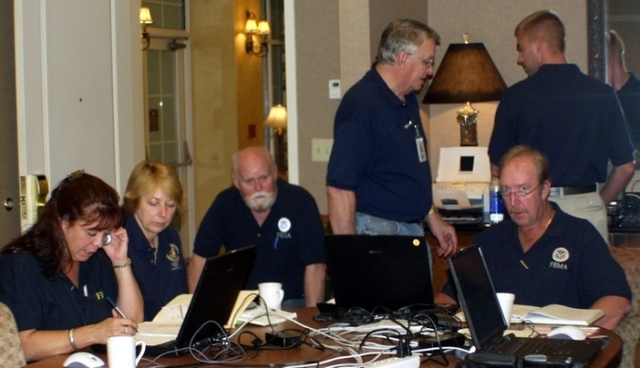
Course Objectives
Define Continuity of Operations.
Explain the benefits of developing a viable continuity program.
Identify the elements of a viable continuity program.
Identify the processes, resources, and tasks necessary to implement and manage a successful continuity program.

Slide 5
Course Agenda
 | AM | PM
Day 1 | Unit 1: Introductions and Course Overview Unit 2: Requirements for Continuity Planning Unit 3: Elements of a Viable Continuity Program (Part I) | Unit 4: Elements of a Viable Continuity Program (Part II) Unit 5: Developing Continuity Plans and Procedures
Day 2 | Unit 6: Operating in a Continuity Environment Unit 7: Developing a Corrective Action Program Unit 8: Family Support Planning | Unit 9: Outreach and Resources Unit 10: Course Summary Train-the-Trainer Preparation Appendix A: Delivering Effective Training

Slide 6

Administrative Information
  Hours
  Evacuation routes and fire exits
  Restrooms
  Smoking
  Breaks
  Please put your cell phone/pager
  on vibrate!

Slide 7
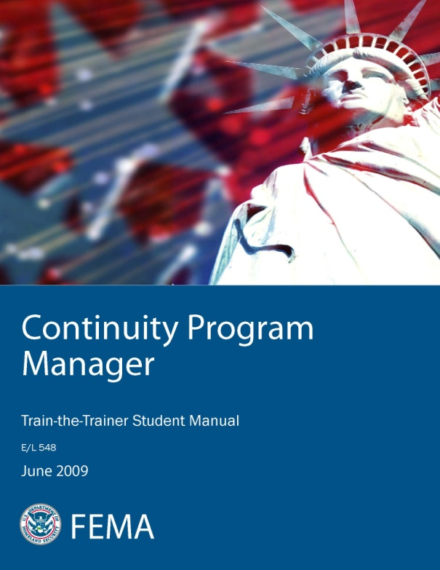
Course Materials
  The Student Manual includes:
  Course content.
  Activities.
  Job aids.
  Course visuals.

Slide 8
Why Have a Continuity Program?
Why should your agency have a continuity program?

Slide 9
Why Have a Continuity Program?
  Continuity planning:
  Ensures the continuity of essential functions across a wide range of emergencies and events.
  Enables agencies to continue the functions that their customers depend on.
  Is part of the fundamental mission of all agencies.
  Today’s changing threat environment has increased the need for a continuity program.

Slide 10
Summary and Transition
This unit:
  Introduced you to the course objectives.
  Presented the course materials.
  Introduced and defined Continuity of Operations.
  Described the need for a continuity program within each agency.
  Unit 2:
  Will cover the legal basis for continuity planning.

Slide 11
Summary and Transition
Questions?

Slide 12
Unit 2: Requirements for Continuity Planning

Slide 13
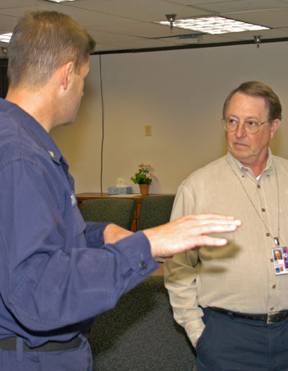
Unit Objectives
Describe the requirements of NSPD 51/HSPD 20.
Describe the guidance in FCD 1.
Identify the objectives of Continuity of Operations.
List the roles and responsibilities of the key players in a continuity program.
2-1

Slide 14
Purpose of a Continuity Program
Why develop a continuity program?
2-2

Slide 15
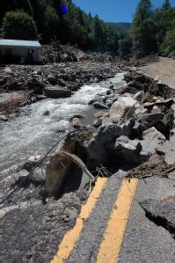
Purpose of a Continuity Program
To document and ensure the capability of continuing agency essential functions during a wide range of potential emergencies.
Goals:
Protect life and property.
Provide for the continuity of essential services until normal operations can be resumed.
2-3

Slide 16
Continuity Planning Objectives
What are some of the objectives realized by planning for Continuity of Operations?
2-4

Slide 17
Continuity Planning Objectives
  Continuity planning helps to:
  Ensure continued performance during a continuity situation.
Reduce loss of life and minimize damage and loss to critical processes and information.
Ensure successful succession to office.
Anticipate what might occur in order to mitigate disruptions.
Ensure that facilities are available during a continuity situation.
2-5

Slide 18
Continuity Planning Objectives
Continuity planning helps to:
Protect essential facilities, equipment, and vital records.
Achieve a timely and orderly recovery from a continuity situation.
Resume full service after an effective reconstitution.
Maintain a test, training, and exercise program that supports the implementation of continuity plans.
2-6

Slide 19
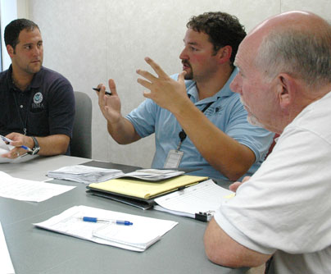
Legal Basis for Continuity of Operations
Continuity of Operations is a Federal initiative, required by Presidential directive.
Federal Executive Branch agencies are required to continue their essential functions under a broad range of circumstances.
2-7

Slide 20

Key Federal Directives
To ensure continuity of essential functions:
    NSPD 51/HSPD 20, issued May 2007
To provide guidance for continuity of essential functions during all-hazard situations:
    FCD 1, issued November 2007.
2-8

Slide 21

NSPD 51/HSPD 20
Requires all Federal Executive Branch agencies to incorporate continuity into their daily operations
Establishes NEFs for all continuity programs
Assigns categories to each agency in accordance with its national security role and responsibilities
Designates the National Continuity Coordinator to lead the development of a National Continuity Implementation Plan
2-9

Slide 22
NSPD 51/HSPD 20 Requirements
Continuity plans must include:
Plans to continue performance of PMEFs for 30 days or until normal operations can be resumed.
Capability to be fully operational at continuity sites within 12 hours after plan activation.
Orders of succession and delegations of authorities.
Measures to safeguard and access vital records and resources.
Provisions for acquiring resources for continued operations.
2-10

Slide 23
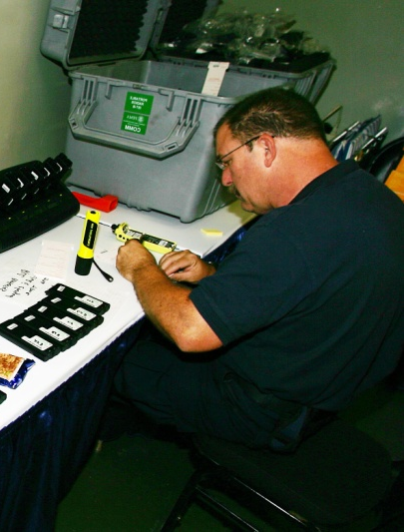
NSPD 51/HSPD 20 Requirements
  Continuity plans must include:
Redundant communications capabilities at continuity sites.
Identification, training, and preparedness of the ERG.
Reconstitution capabilities.
2-11

Slide 24
FCD 1
FCD 1:
Provides direction to the Federal Executive Branch for developing continuity plans and programs to support continuation of NEFs.
Identifies three supporting components and 10 primary elements for a viable continuity capability.
2-12

Slide 25
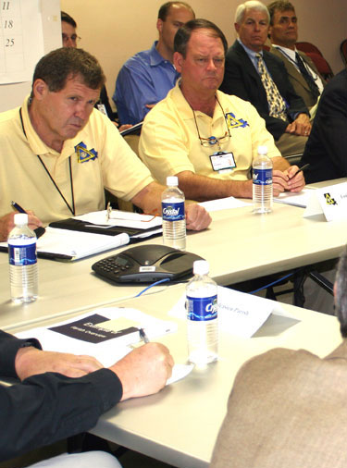
FCD 1 Support Component 1
Continuity Plans and Procedures:
Developing effective plans and procedures includes a TT&E program and the operational capability to implement the plans and procedures.
Establishing planning and procedural objectives and requirements is an essential part of developing a viable continuity plan.
2-13

Slide 26
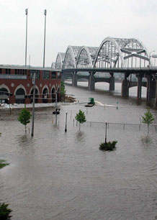
FCD 1 Support Component 2
Risk Management:
A structured process for understanding the problems facing an organization:
  What can go wrong?
  How bad can it get? How fast?
  What is the likelihood that the undesired event might occur?
  What would be the impact should it occur?
2-14

Slide 27

FCD 1 Support Component 3
Budgeting and Acquisition of Resources:
Agencies must align and allocate the budgetary resources necessary to implement and manage the continuity program.
2-15

Slide 28
FCD 1 Support Component 3
What resources do you need to consider when you complete budgeting and acquisition?
2-16

Slide 29
FCD 1 Support Component 3
Budgeting and Acquisition of Resources:
    Human capital
    Communications
    Facilities
    Infrastructure (systems, etc.)
    Transportation
2-17

Slide 30

FCD 1 Primary Elements
10 elements ensure a viable continuity program:
Essential functions
Orders of succession
Delegations of authority
Continuity facilities
Continuity communications
Vital records management
Human capital
Tests, training, and exercises
Devolution of control and direction
Reconstitution operations
2-18

Slide 31
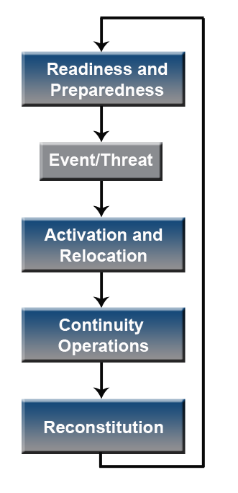
Continuity of Operations Implementation
Phases of continuity plan implementation:
Readiness and preparedness
Activation and relocation
Continuity operations
Reconstitution
2-19

Slide 32
Continuity Roles and Responsibilities
FEMA is:
The lead agent for continuity planning within the Federal Executive Branch.
Responsible for issuing guidance to promote the understanding of and compliance with Federal mandates and requirements.
The responsibility for actual continuity planning lies within each Federal agency.
State and local governments should designate their own lead agents for continuity planning.
2-20

Slide 33

Role of Non-Federal Jurisdictions
State, local, territorial, and tribal governments play an integral role in:
Determining the needs of the public.
Ensuring that essential functions continue on a daily basis.
2-21

Slide 34

Agency Roles and Responsibilities
All Federal departments and agencies are responsible for carrying out the direction of NSPD 51/HSPD 20.
Regardless of government level, continuity planning responsibilities fall to several department/agency levels.
2-22

Slide 35
Role of the Agency Leader
How are agency leaders involved in continuity planning?
2-23

Slide 36

Role of the Agency Leader
Agency leaders establish continuity planning as a priority by:
Appointing a Continuity Program Manager.
Ensuring budgetary support.
Monitoring the progress of the continuity planning effort.
2-24

Slide 37
Role of the Continuity Program Manager
The Continuity Program Manager:
Oversees the overall development of the continuity plan.
Serves as the agency’s coordinator for Continuity of Operations.
Is responsible for developing, coordinating, and managing all activities enabling the performance of essential functions during a continuity situation.
Chairs the agency’s internal continuity planning team or CWG.
2-25

Slide 38
Continuity Program Manager Skills
What skill sets are needed by the Continuity Program Manager?
2-26

Slide 39

Continuity Program Manager Skill Sets
Skills that every Continuity Program Manager needs are:
Business management skills.
Interpersonal skills.
Communication skills.
Facilitation skills.
2-27

Slide 40

Role of the Continuity Planner
The Continuity Planner manages day-to-day continuity plan development:
Coordinating with the planning team
Managing plan development
Overseeing tests, training, and exercises; corrective action planning; and long-term planning efforts
2-28

Slide 41

Role of the Continuity Planning Team
Members of the continuity planning team should be:
Selected based on their expertise in specific areas related to the agency’s essential functions.
Assigned specific portions of the continuity plan to research and develop.
Able to work collaboratively
with other team members.
2-29

Slide 42
Role of the ERG
Responsibilities of the Emergency Relocation Group (ERG) are to:
Participate in continuity tests, training, and exercises.
Prepare office go kits that contain all of the information, supplies, and materials needed initially for continuity plan activation.
Ensure that they and their families are prepared for an emergency that may require continuity plan activation.
Report to the continuity facility, or other assigned work area, whenever the continuity plan is activated.
2-30

Slide 43
Summary and Transition
This unit:
Explained the legal requirements for continuity planning.
Identified the objectives of Continuity of Operations.
Described the roles and responsibilities of key players in a continuity program.
  Unit 3:
  Will cover elements of a viable continuity program.
2-31

Slide 44
Summary and Transition
Questions?
2-32

Slide 45
Unit 3: Elements of a Viable Continuity Program (Part I)

Slide 46

Unit Objectives
Identify your agency’s essential functions.
Determine whether orders of succession meet the requirements of FCD 1.
Determine whether delegations of authority cover all critical functions.
Determine if continuity facilities are adequate.
Describe the requirements for continuity communications.
3-2

Slide 47
What Is an Essential Function?
What is an essential function?
3-3

Slide 48
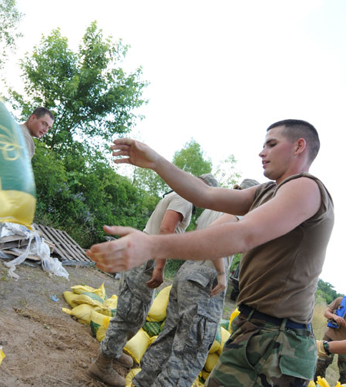
What Is an Essential Function?
FCD 1 defines essential functions as those functions that are required to:
Provide vital services.
Exercise civil authority.
Maintain the safety of the
general public.
Sustain the economic base
during an emergency.
Essential functions are an agency’s business functions that must continue with no or minimal interruption.
3-4

Slide 49

Types of Essential Functions
FCDs 1 and 2 define three types of essential functions:
National Essential Functions (NEFs)
Primary Mission Essential Functions (PMEFs)
Mission Essential Functions (MEFs)
State, local, territorial, and tribal governments use FCD 1 and FCD 2 as guides to define essential functions.
3-5

Slide 50
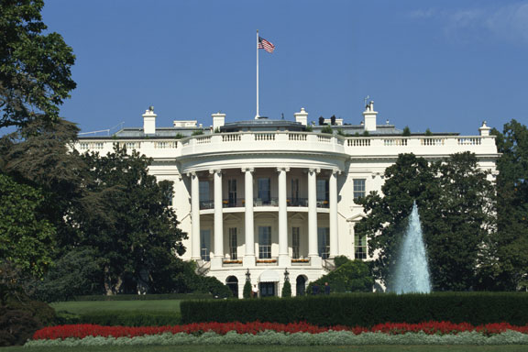
National Essential Functions (NEFs)
NEFs are the subset of government functions necessary to lead and sustain the Nation during a catastrophic emergency.
NEFs must be supported through continuity capabilities.
    State and tribal governments may have an equivalent to NEFs.
3-6

Slide 51
Primary Mission Essential Functions (PMEFs)
PMEFs are those agency mission essential functions that must be performed to support or implement the performance of NEFs before, during, and after an emergency.
PMEFs:
Must be performed continuously during an event or resumed within 12 hours of an event.
Need to be maintained for up to 30 days after an event or until normal operations can be resumed.
3-7

Slide 52
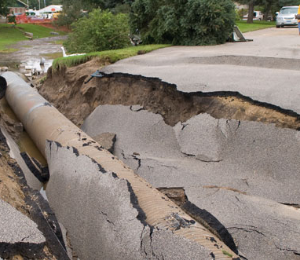
Mission Essential Functions (MEFs)
MEFs must be performed to support or implement the performance of Federal, State, local, territorial, or tribal essential functions before, during, and after an emergency.
MEFs include:
Personnel safety.
Public safety.
A safe, functioning infrastructure.
3-8

Slide 53

Identifying Mission Essential Functions
Identify PMEFs and MEFs by referring to laws, Presidential Directives, Executive Orders, and other authorities that dictate agency functions.
Consider functions that:
Must be continued in all
circumstances.
Cannot be interrupted for
more than 12 hours.
3-9

Slide 54
FCD 2 Guidance
FCD 2: Federal Executive Branch Mission Essential Function and Primary Mission Essential Function Identification and Submission Process
FCD 2:
Provides guidance for identifying MEFs and PMEFs.
Applies to all Federal Executive Branch departments and agencies.
Is useful for State, local, territorial, and tribal governments, and nongovernmental organizations (NGOs).
3-10

Slide 55

Prioritizing MEFs
Prioritize MEFs according to:
Their relationships to PMEFs.
The criticality of the function.
Likely continuity activation protocols and scenarios.
3-11

Slide 56

Drivers of Essential Functions
Essential functions are driven by:
Trained personnel (human capital).
Vital records and databases.
Supplies.
Equipment and systems.
These vital resources must be
safeguarded, available, and
accessible to support Continuity
of Operations.
3-12

Slide 57

Other Government Functions
Agencies also need to identify all functions that they perform that do not rise to the level of PMEFs or MEFs.
Example:
Payroll and personnel actions
are government functions that
must continue during a continuity
situation.
3-13

Slide 58

Activity: Identifying Essential Functions
Instructions:
Work in your group to complete this activity.
Consider your agency’s mission and critical services.
Identify one PMEF for your agency.
Identify one MEF that supports the identified PMEF.
Identify one function that is not a PMEF or MEF but is required to support the identified PMEF and MEF.
You have 10 minutes to complete this activity.
3-14

Slide 59
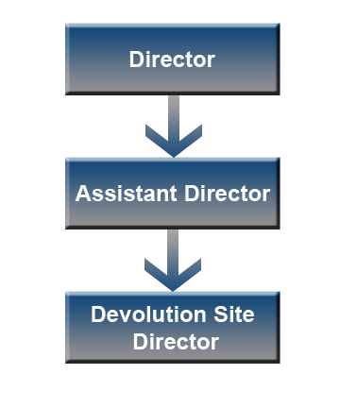
Orders of Succession
Orders of succession provide for the orderly, predetermined assumption of senior agency offices during an emergency in the event that any officials are unavailable or unable to execute their legal duties.
Recommendations:
Support day-to-day operations
Three deep
One of three should not be located at
the primary facility
3-15

Slide 60
Information in Orders of Succession
All orders of succession should include the:
Conditions under which succession takes place.
Method of notification.
Conditions under which authority returns to the agency leader.
All orders of succession should be:
Reviewed by the agency’s General Counsel.
Maintained with the agency’s vital records.
3-16

Slide 61
Delegations of Authority
Delegations of authority:
  Specify the activities that may be performed by those authorized to act on behalf of the agency head or other key officials.
Document the legal authority for officials to make key policy decisions during a continuity situation.
Delegations of authority ensure:
Continued operation of essential functions.
Rapid response to any emergency situation requiring continuity plan implementation.
3-17

Slide 62
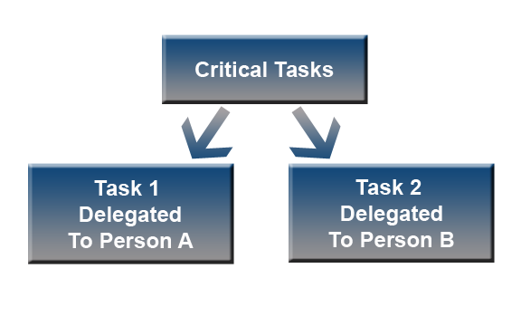
Information in Delegations of Authority
Delegations of authority state specifically:
The authority being delegated.
The limits of that authority.
To whom the authority is delegated.
The circumstances under
which delegated authorities
become effective and when they
terminate.
The successor’s authority to
redelegate those authorities.
3-18

Slide 63
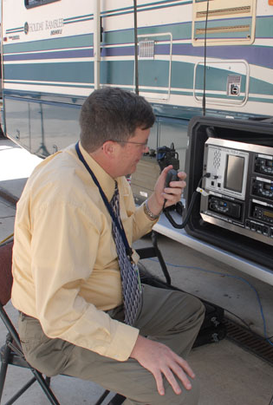
Continuity Communications
. . . The capability to continue communications with internal and external customers until normal operations can be resumed.
Effective continuity communications supports:
Execution of the agency’s essential functions.
Internal and external communications.
Access to data, systems, and services.
3-20

Slide 64

Continuity Communications
Continuity communications must be:
Redundant.
Available within 12 hours of activation.
Sustainable for up to 30 days, or until normal operations can be resumed.
3-21

Slide 65
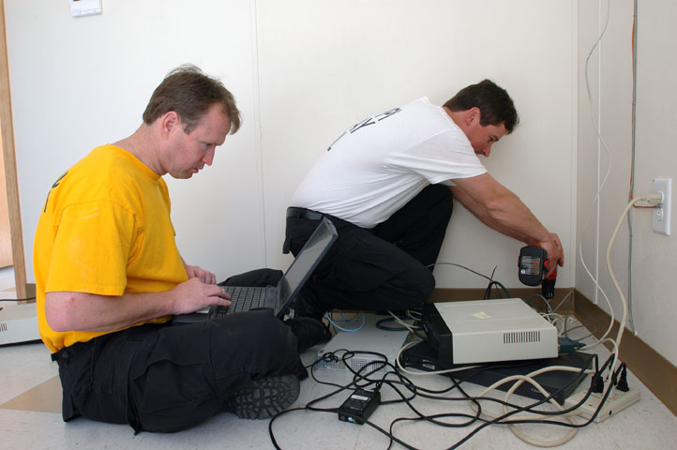
Continuity Facilities
FCD 1 requires the identification of a location, other than the primary facility, that can be used to carry out essential functions in a continuity situation.
Agencies should also identify one or more devolution sites in case the continuity facility is inoperable.
3-22

Slide 66
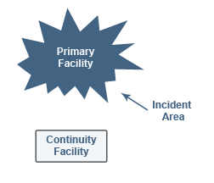
Continuity Facilities
Selecting a suitable continuity facility involves:
Analyzing a range of factors.
Prioritizing the factors based on the agency’s requirements.
Locating a distance from the primary facility to avoid impact from the incident.
3-23

Slide 67

Summary and Transition
This unit:
Reviewed some of the elements of a viable continuity program.
  Unit 4:
Will cover the remaining essential elements of a viable continuity program.
3-24

Slide 68
Summary and Transition
Questions?
3-25

Slide 69
Unit 4: Elements of a Viable Continuity Program (Part II)

Slide 70
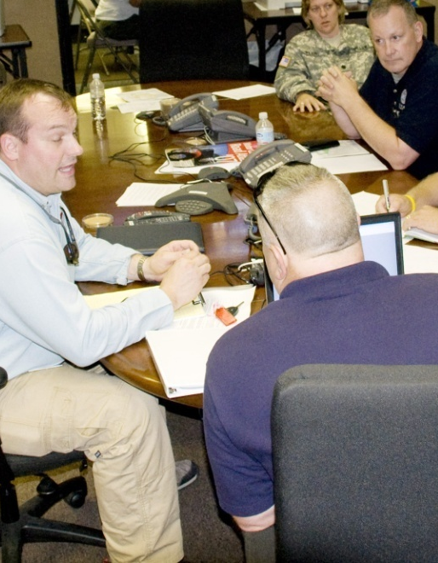
Unit Objectives
Describe a vital records program.
Identify special human capital issues in a continuity situation.
Identify the steps for developing a viable devolution plan.
Describe the process for reconstitution operations.
Explain the components of an effective test, training, and exercise program.
4-2

Slide 71

Vital Resource Management
Vital resources are the personnel, equipment, systems, infrastructure, supplies, and other assets required to perform essential functions. These assets:
Must be safeguarded, available, and accessible to support continuity operations.
Depend on a vital records program to manage the identification, protection, and ready availability of electronic and hardcopy documents.
4-3

Slide 72
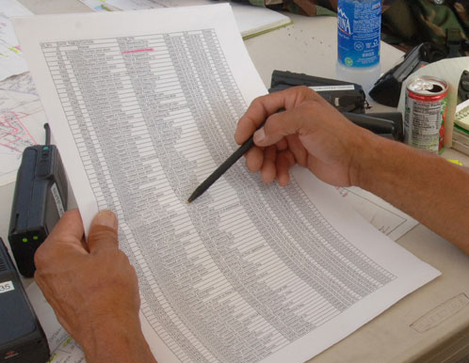

Identifying Vital Records
Emergency operating records:
Plans and directives
Orders of succession
Delegations of authority
Staffing assignments
Rights and interests records:
Personnel records
Social Security records
Payroll records
Retirement records
Insurance records
Contract records
4-4

Slide 73

Types of Vital Records
There are two types of vital records:
Static records change little or not at all over time.
Active records change constantly with circumstances or as work is completed.
Both types of vital records are essential so that operations can be maintained, or resumed quickly, following an interruption.
4-5

Slide 74
Activity: Identifying Vital Records
Instructions:
Work in your group to complete this activity.
Refer to the PMEF you developed in Unit 3.
Identify as many vital records as possible required to support the PMEF.
You have 15 minutes to complete this activity.
4-6

Slide 75

Getting a Vital Records Program Started
A vital records program involves:
Establishing and assigning responsibility for the program.
Developing a records maintenance program.
Testing the program to ensure that it works as planned.
4-7

Slide 76
Information to Establish a Vital Records Program
What information do you need to establish a vital records program?
4-8

Slide 77

Vital Records Program Questions
What records are vital for continuity?
How many vital records are there?
On what media do the records exist?
How often do they require change or updating?
Where are the vital records located?
Are the vital records classified? At what level?
4-9

Slide 78

Vital Records Program Questions
Who needs to use the vital records on site?
Is the need immediate?
How much storage is available on site?
Is the storage facility climate controlled?
Is access to the storage facility limited?
Is a records recovery plan or strategy in place?
4-10

Slide 79
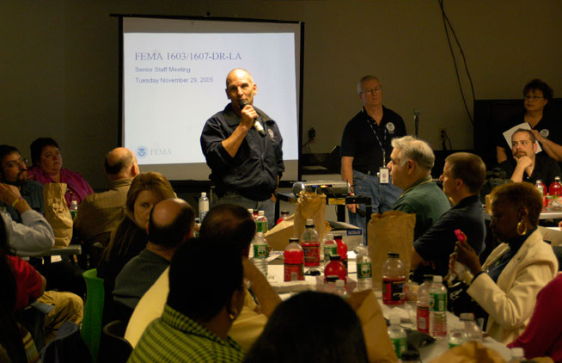
Human Capital
. . . the sum of talent, energy, knowledge, and enthusiasm that people invest in their work.
In continuity situations, agencies have to perform essential functions with reduced staffing.
Agencies should ensure that
all ERG personnel are trained and
cross-trained to perform all
essential functions.
4-11

Slide 80

Human Capital Considerations
Concerns for human capital in continuity situations include:
Designating the ERG.
Communicating with all employees.
Providing guidance to all employees.
Using telework and continuity locations.
4-12

Slide 81

Designating the Emergency Relocation Group
Employees designated as part of the ERG must:
Possess the skills for their assigned function(s).
Be able to remain calm in an emergency.
Be trained and equipped to perform their continuity assignments.
4-13

Slide 82


Communicating With Employees
Notify primary and alternate ERG personnel in writing.
Keep all employees informed of agency status, from plan activation through reconstitution.
4-14

Slide 83
Information to Provide to All Employees
What information should you provide to all employees?
4-15

Slide 84
Information to Provide to All Employees
A phone number or other means of getting information
The information that will be included on the recording (agency status, pay information, etc.)
How often information will be updated
What to do and who to contact if other information is required
The types of information that will be provided (and to whom)
4-16

Slide 85
Information to Provide to All Employees
How can you provide necessary information to all employees?
4-17

Slide 86
Communicating With Employees
Ways to ensure that all personnel know what to do in a continuity situation include:
Scheduling meetings to explain what to expect and what to do upon continuity plan activation.
Conducting regular drills and other exercises.
Establishing and testing an agency notification system for ERG and non-ERG personnel.
Developing and testing procedures to account for all employees in an emergency.
4-18

Slide 87

HR Needs During Continuity Operations
A continuity situation raises personnel questions that only a human resources (HR) officer can answer.
HR officers are familiar with and understand human capital:
Tools.
  Flexibilities.
  Strategies.
4-19

Slide 88

HR Needs During Continuity Operations
Continuity-specific human capital issues include:
Pay and leave.
Telework and alternate work locations.
Work schedules.
Hiring.
Benefits.
4-20

Slide 89

Alternate Work Locations―Telework
Telework allows employees to conduct some or all of
their work at an alternative worksite away from the
employer’s usual office.
Telework is a way to:
Increase workforce flexibility.
Involve more agency personnel in continuity operations.
4-21

Slide 90

Alternate Work Locations―Telework
Telework locations can include:
An employee’s residence.
A telework center.
A traditional office or satellite office close to the employee’s residence.
An office located in another State or county.
Telework schedules vary and are subject to management approval.
4-22

Slide 91
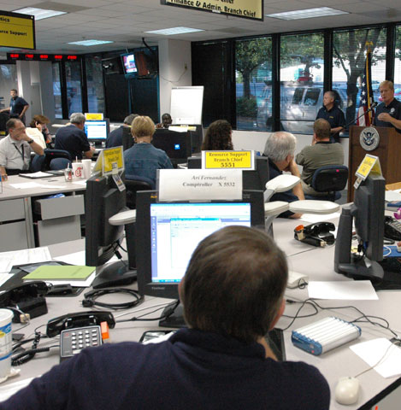
Devolution of Control and Operations
Devolution:
  Is the capability of transferring authority and responsibility from an agency’s primary operating staff and facilities to other employees and facilities.
Addresses disasters that render an agency’s leadership and staff unavailable or incapable of performing essential functions from either its primary or continuity facilities.
4-30

Slide 92
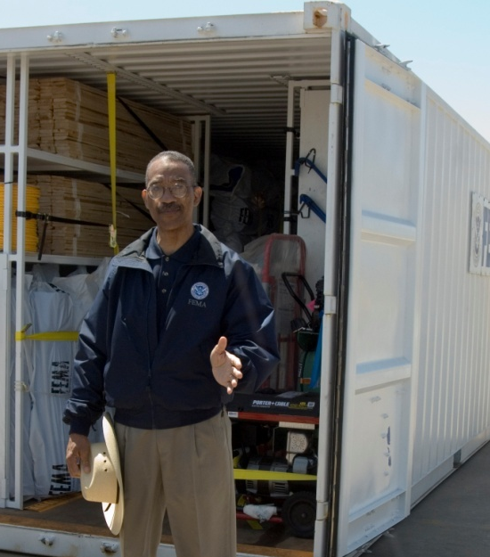
Devolution Planning
The devolution plan:
Addresses how the agency will identify and transfer its essential functions in the aftermath of a catastrophic disaster.
Provides procedures, guidance, and an organizational structure for the receiving organization to ensure that essential functions are continued.
4-31

Slide 93
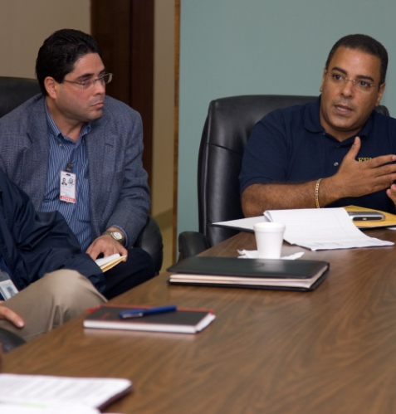
Developing a Devolution Plan
Developing a devolution plan involves:
Prioritizing essential functions that must devolve.
Creating a roster of personnel equipped to perform their assigned essential functions from the devolution site.
Identifying activation protocols for the devolution plan.
4-32

Slide 94
Developing a Devolution Plan
The devolution plan must include:
A description of how and when control of agency operations will be transferred.
A list of the resources required to continue essential functions and sustain operations.
Reliable processes and procedures for acquiring necessary resources.
Capabilities for restoring—or reconstituting—agency authorities to their pre-event status.
4-33

Slide 95
Devolution Planning Template
FEMA has developed a Devolution Planning Template to guide continuity planners in developing the devolution plan.
Devolution Planning (DEVOP) Template
(Organization Logo)
4-34

Slide 96

Reconstitution
Reconstitution is the process by which agency personnel resume normal agency operations at the primary operating facility.
Agencies must outline a plan to return to normal operations after agency leaders determine that reconstitution operations can begin.
4-35

Slide 97
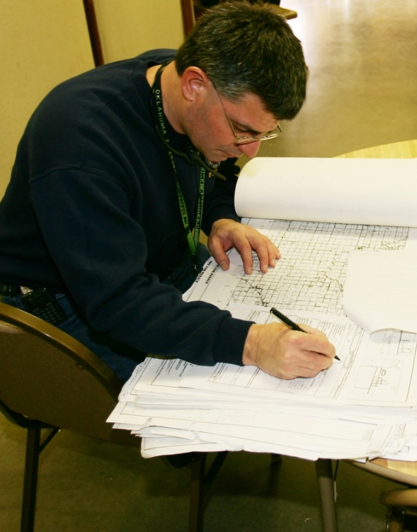
Reconstitution
Reconstitution operations should be overseen by a Reconstitution Manager.
The Reconstitution Manager should not be the Continuity Program Manager or Coordinator, who have other duties to perform during a continuity event.
4-36

Slide 98
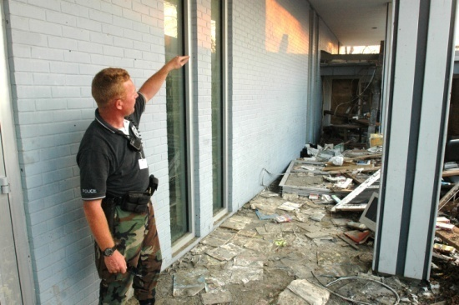
Reconstitution Planning
Reconstitution involves three main tasks:
Transitioning from continuity status to normal operations after the disruption has passed.
Coordinating and planning for reconstitution regardless of the level of disruption.
Outlining the procedures for a smooth transition from a relocation site to a restored facility.
4-37

Slide 99
Implementing the Reconstitution Plan
Reconstitution is a five-step process:
Notify all personnel that the threat or actual emergency no longer exists.
Provide instructions for the resumption of normal operations.
Supervise the orderly return to the normal operating facility.
Report agency status, as appropriate.
Conduct an after-action review of continuity operations.
4-38

Slide 100
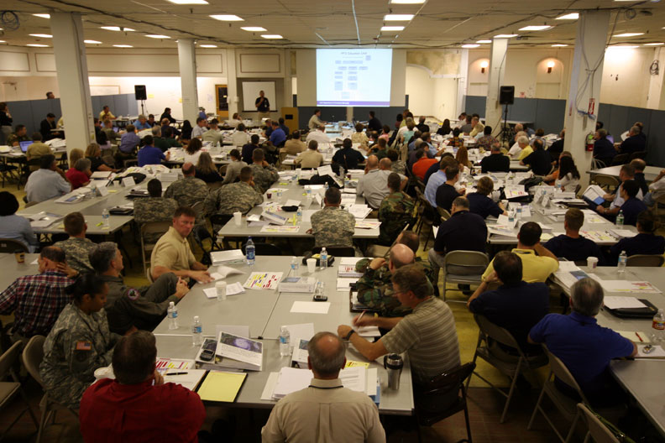
Test, Training, and Exercise (TT&E)
A TT&E program:
Verifies that essential functions can continue as planned.
Provides the framework for promoting consistency and uniformity in job performance.
Ensures that TT&E events support the common overall goal of mission readiness.
4-23

Slide 101
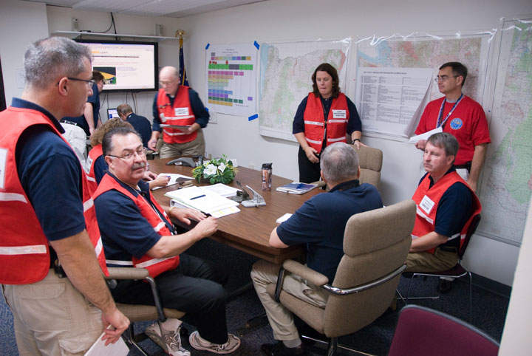
Test, Training, and Exercise (TT&E)
TT&E should be a comprehensive blend of test, training, and exercise events that:
Confirm that the plan works as intended, or points to areas requiring improvement.
Reflects lessons learned from previous TT&E events or activations.
Improves overall mission readiness.
Provides opportunities to
acquire and apply the skills and
knowledge needed for continuity
operations.
Builds team unity.
4-24

Slide 102

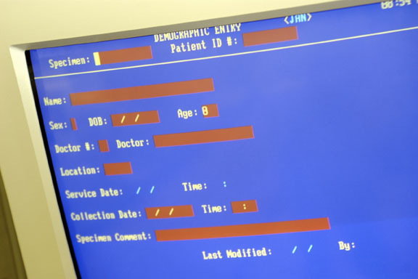
TT&E―Tests
All systems must be tested as part of continuity planning. Tests are:
Systems oriented.
Interactive.
Realtime.
4-25

Slide 103

TT&E―Training
Types of training:
Lecture/discussion
Hands on:
    On-the-job
    Job shadowing
    Mentoring
    Simulations
4-26

Slide 104
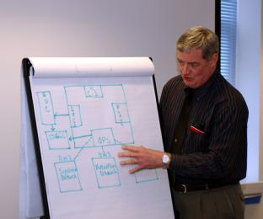
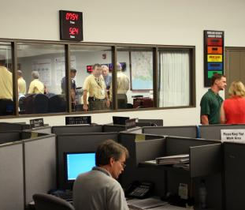
TT&E―Exercises
Seminars
Workshops
Tabletops
Games
Drills
Functional exercises
Full-scale exercises
4-27

Slide 105
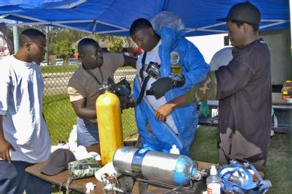
TT&E―Exercises
Exercises are “proof of performance.” Exercises involve several key components:
An exercise plan
A control plan
An evaluation plan
A Player Handbook
A Corrective Action Program
4-28

Slide 106

TT&E Checklist
A TT&E Checklist helps to:
Manage the exercise development, conduct, and evaluation process.
Ensure that exercises are developed logically and that no important details are overlooked.
4-29

Slide 107

Summary and Transition
This unit:
Covered several of the essential elements of a continuity plan.
  Unit 5:
Will cover how to develop
continuity plans and
procedures
4-39

Slide 108
Summary and Transition
Questions?
4-40

